Slide 1



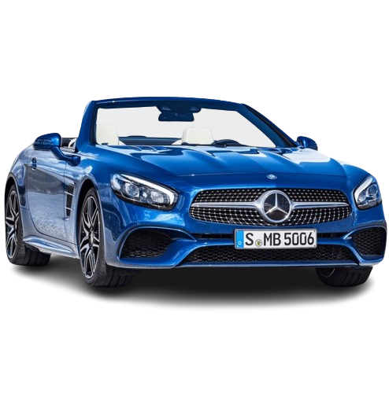
FSD PROJECT
Title
Introduction
Functionalities
Problem Solved
Future Scope
Car Sales
AUTOMOBILE WEBSITE
By Chirag Patel
Computer Ennginering
A3
22002170110107

Slide 2
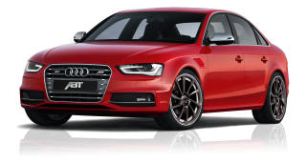
Title
Introduction
Functionalities
Problem Solved
Future Scope
We have developed An website of an automobile industry where we have bring all luxurious brand together
With Help Of HTML CSS and JS made these website

Slide 3
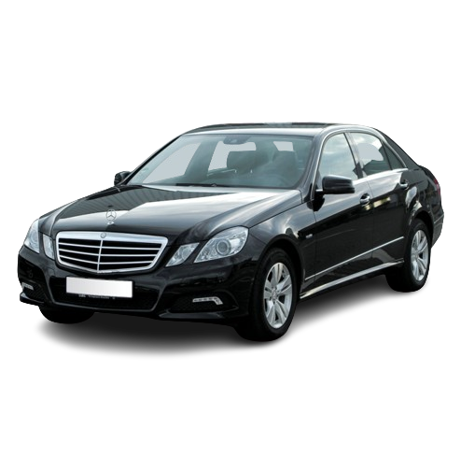
Title
Introduction
Functionalities
Problem Solved
Future Scope
Getting Signed Up And Logged In
Bring All Luxurious Brand Together
Every cars specifications
Facility to Book A Test Drive
Exploring All Cars by any Names

Slide 4

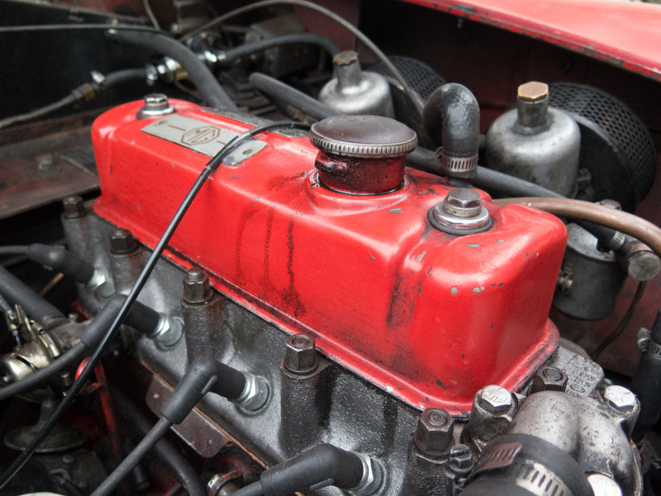

Problem Solved
Future Scope
Title
Future Scope
Title
Introduction
Introduction
Functionalities
Functionalities
Surffing different wesbites for different comapnies
Calling and asking dealers about specifications
Rumoring around for test drives
Due to Maintainence website should lack so test drive booking will be effected
Sometimes Company provide us wrong info about prices and
specifications

Slide 5

Problem Solved
Future Scope
Title
Future Scope
Title
Introduction
Introduction
Functionalities
Functionalities
Decoding with bugs and making it hassle free experience
Integrating With Advance Jquery
Showing data of more cars not just 80 90 cars dynamically
Making Interface for comparision between two or more cars

Slide 6
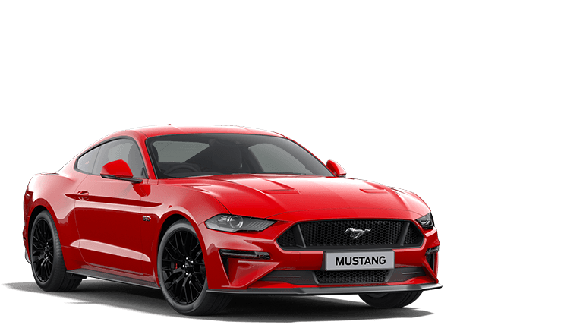
Thank You!

